Slide 1


Will you be Ready for A-F Accountability? Let's Align
Ty Duncan
Coordinator of Accountability and Compliance
Region 17 Education Service Center
@instructionalle on Twitter
#ESC17 #AIEConf

Slide 2

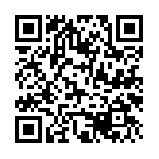
These slides posted on our blog!
http://www.esc17.net/default.aspx?name=blog.instructionalleaders

Slide 3

TWEET For Door Prizes!
#ESC17
#AIEConf

Slide 4
Accountability System Alignment!
Civil Disobedience
Transformation

Slide 6
What Makes Campus IR?
#AIEConf

Slide 7
There is a definite correlation between Index 1 and Index 3.
Achieving at the top end is creating as many IR campuses as students who do not pass.
The concept of student growth has not become a cultural part of some campuses.

Slide 9
#AIEConf

Slide 12

Concept of Targets
#ESC17

Slide 13
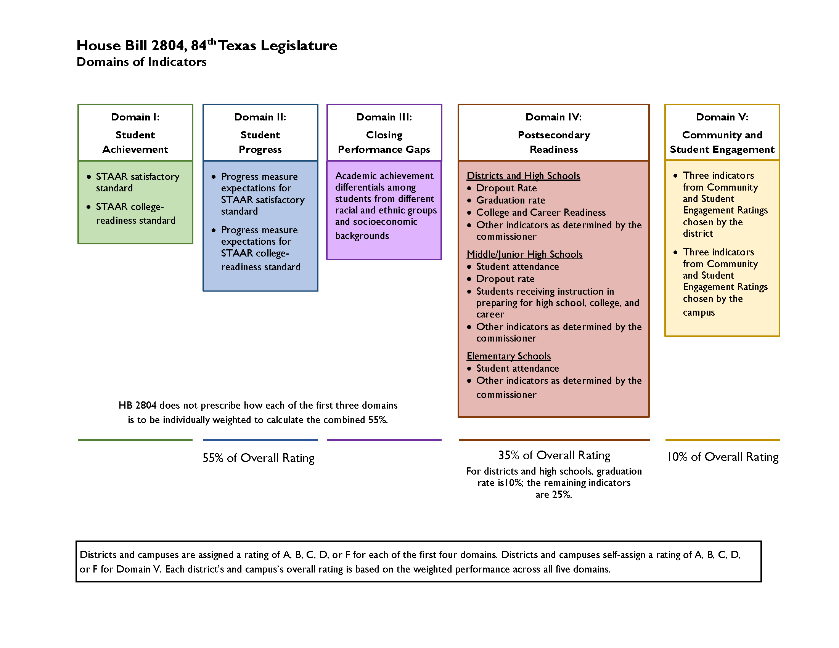

Slide 14
Teachers need to get used to the idea of multiple standards.
Culturally we must kill the “just passing” mindset
What will these standards look like and will we make sure campus goals revolve around the higher standard!
#AIEConf

Slide 15
"Accountability has to be about 'how much did we grow them,' not 'how much did they come in with'" – Commissioner Morath, TASA/TASB Convention, September 2016
This domain is most likely going to receive the most weight of the 55% demanded by statute.
One of the things we learned from the past index system is that if you will focus on growth a lot of the system will take care of itself.
It is reasonable to expect a different kind of students growth measure than what was in the previous system.

Slide 16
How to measure “differentials” is the real issue in creating a policy decision.
Economically disadvantaged students will still be used inside the indicator. Research is clear that poverty a substantial inhibitor of performance.
Unsure of how Level III students will used.
This indicator could give you a bump up in the other two domains if a high score is achieved.
#AIEConf

Slide 17
STAAR cannot be used inside this indicator per the statute.
Coming up with other required indicators and creating an equitable target score around these is perhaps the most challenging piece of the legislation.
Gradation rate will be a substantial part of the indicator.
The design is to push increase in SAT/ACT scores, students graduating with college credit, and industry certifications.

Slide 18
Self-report…..
#ESC17

Slide 19

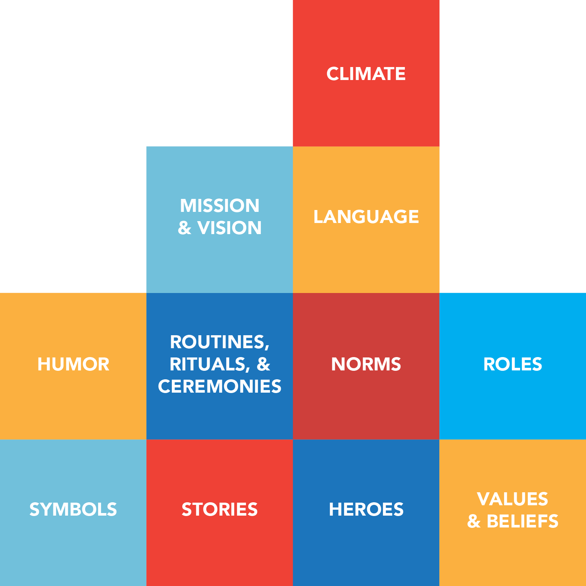
Accountability System Alignment!
Civil Disobedience
Transformation

Slide 20
1) Sophistication of Systems and Beliefs
Planning for student leadership; student data/standard awareness; teaching learning
Instruction determined by students and their needs; instillation of concern
Learning environment that hinges on student competency; creating culture (CONTAGIOUS)
Professional practices and responsibilities that contribute to vision and mission focus
Notes:
Important for TTESS not to become compliance…if done with fidelity and purpose, can make change.

Slide 21
2) More Than “Just Passing!”
Growth as a cultural value!
What data do you publish first?
What language do you use to ensure a growth mindset?
What do you celebrate?
#ESC17

Slide 22

3) Urgency
The days of relaxed, casual schooling are over.
Tactics from John Kotter!
  Bring the Outside In!
  Behave with Urgency Everyday!
  Find Opportunity in Crisis
  Deal with No No’s
Response Time!

Slide 23
4) Use Campus Comparison Groups to Provide Context to the Work!
ELL
Affluent
Campus
Type
Magnet
Early College
Poverty
Mobility

Slide 24
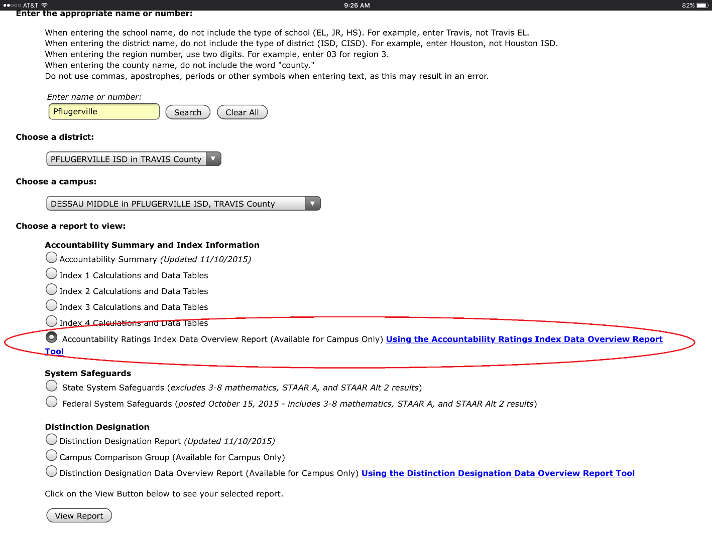
Campus Comparison Group Tool

Slide 25
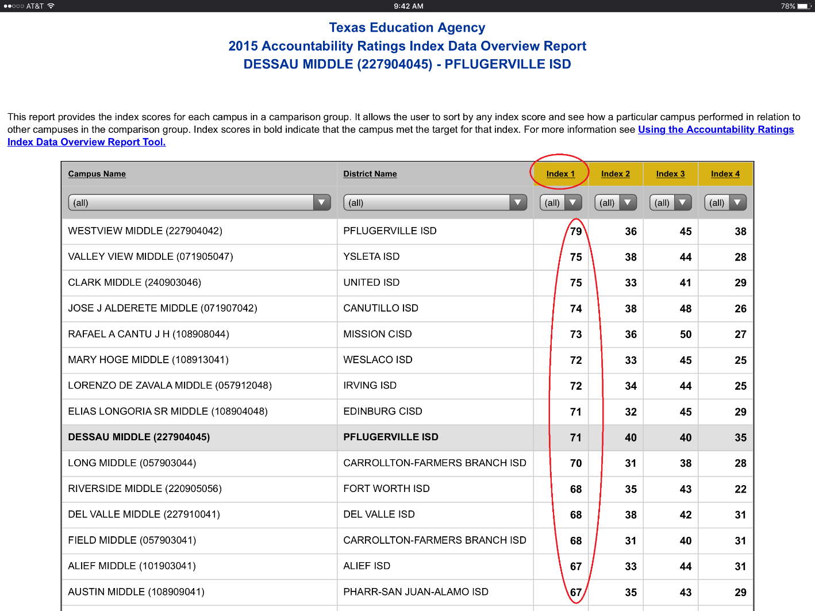

Slide 26
Ty Duncan
Coordinator of Accountability and Compliance
Region 17 Education Service Center
@instructionalle on Twitter
#ESC17 #AIEConf tduncan@esc17.net

